Slide 1
Git
Grunnámskeið í notkun á Git
Notes:
We are here to tell you a little bit about our operations and how our services can benefit your company

Slide 2
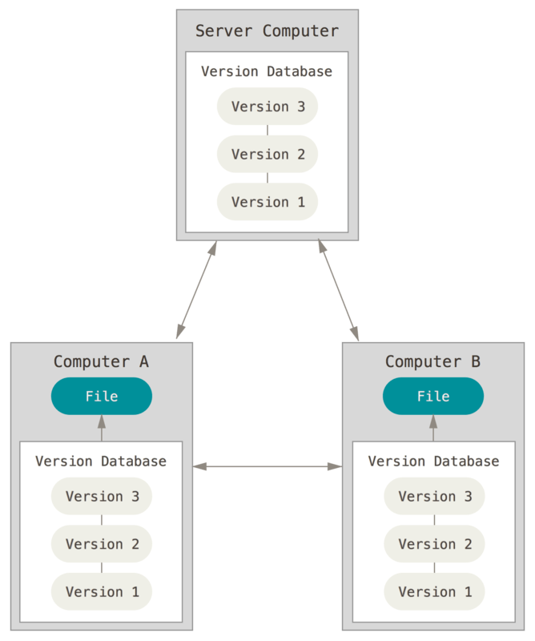
Um Git
Dreifð útgáfustýring (e. Distributed Version Control System DVCS)
Pro Git, Önnur Útgáfa, 2004, Scott Chacon & Ben Straub
Notes:
We pride ourselves in being a one-stop-shop for all your IT needs and take great pleasure in providing our customers with the best possible service, a diverse but integrated range of solutions and services, a competent and innovative professional staff, and proven managerial skills.

Slide 3
Hefjumst handa
Git vs GitHub
https://git-scm.com/downloads
Sækið og installið git.
Búið til möppuna gitnamskeid þar sem hentar. T.d. c:\gitnamskeid

Slide 4


allt á einum stað
Notes:
We pride ourselves in being a one-stop-shop for all your IT needs and take great pleasure in providing our customers with the best possible service, a diverse but integrated range of solutions and services, a competent and innovative professional staff, and proven managerial skills.

Slide 5
allt á einum stað
Notes:
We pride ourselves in being a one-stop-shop for all your IT needs and take great pleasure in providing our customers with the best possible service, a diverse but integrated range of solutions and services, a competent and innovative professional staff, and proven managerial skills.

Slide 6
allt á einum stað
Notes:
We pride ourselves in being a one-stop-shop for all your IT needs and take great pleasure in providing our customers with the best possible service, a diverse but integrated range of solutions and services, a competent and innovative professional staff, and proven managerial skills.

Slide 7
allt á einum stað
Notes:
We pride ourselves in being a one-stop-shop for all your IT needs and take great pleasure in providing our customers with the best possible service, a diverse but integrated range of solutions and services, a competent and innovative professional staff, and proven managerial skills.

Slide 8
allt á einum stað
Notes:
We pride ourselves in being a one-stop-shop for all your IT needs and take great pleasure in providing our customers with the best possible service, a diverse but integrated range of solutions and services, a competent and innovative professional staff, and proven managerial skills.

Slide 9
allt á einum stað
Notes:
We pride ourselves in being a one-stop-shop for all your IT needs and take great pleasure in providing our customers with the best possible service, a diverse but integrated range of solutions and services, a competent and innovative professional staff, and proven managerial skills.

